Slide 1
Machine Learning and Innovation in Legal Research Technology
Masoud Gerami
Managing Director, Justis/vLex
Notes:
My name is Masoud, and I am the Managing Director at Justis.

Slide 2
Recent changes at Justis
Justis was recently acquired by vLex
The two companies share the same vision - the need for innovation in our industry

Slide 3
More about Justis
Justis is a “legal content and technology” company based in London
Since 1986 Justis has been involved in the electronic dissemination of legal authorities and in the building of legal research software
Justis has undergone a big transformation in recent years, from simply providing case law to a provider of intelligent tools and technologies - to improve legal research.
Notes:
I’d like to talk a little about the work that we’ve been doing, and the changes in the industry that have led us in this direction.

Slide 4
The largest collection of common law cases and legislation
Anguilla
Antigua and Barbuda
Australia
Bahamas
Barbados
Belize
Bermuda
British Virgin Islands
Canada
Cayman Islands
Dominica
European Union
Grenada
Guyana
Ireland
Jamaica
Jersey
Montserrat
New Zealand
Singapore
St. Kitts and Nevis
St. Lucia
St. Vincent & the Grenadines
Trinidad and Tobago
Turks and Caicos
United Kingdom
Notes:
Justis databases and collections include case law and legislation from many common law jurisdictions, including the UK, Ireland, the EU, Australia, Canada and the Caribbean. In fact, we host the largest collection of common law cases available anywhere online, including reported and unreported cases.

Slide 5
Justis + vLex Global Data Coverage
Anguilla
Antigua and Barbuda
Australia
Bahamas
Barbados
Belize
Bermuda
British Virgin Islands
Canada
Cayman Islands
Dominica
European Union
Grenada
Guyana
Ireland
Jamaica
Jersey
Montserrat
New Zealand
Singapore
St. Kitts and Nevis
St. Lucia
St. Vincent & the Grenadines
Trinidad and Tobago
Turks and Caicos
United Kingdom
Andorra
Argentina
Austria
Belgium
Bolivia
Bosnia & Herzegovina
Brazil
Chile
Colombia
Costa Rica
Cuba
Czech Republic
Denmark
Dominican Republic
Ecuador
El Salvador
France
Germany
Guatemala
Honduras
India
Italy
Latvia
Malaysia
Mercosur
Mexico
Netherlands
Nicaragua
Nigeria
Pakistan
Panama
Paraguay
Peru
Philippines
Poland
Portugal
Puerto Rico
South Korea
Spain
Sweden
Switzerland
Thailand
Uruguay
United States
Venezuela
Notes:
And now the coverage of Justis and vLex data collections extends to include the United States, South America, and many other countries.
A truly global coverage…

Slide 6
Common law legal systems
Common law legal systems cover 1/3 of the world’s population – 2.5 billion people!
Principles established in a case are binding or persuasive for deciding subsequent cases
Notes:
I want to share with you one of our initiatives in relation to our common law collection.
And here is the background….
But, what is special or different about the common law legal system?
Two and a half billion people live in a country with a common law legal system. This means 1/3 of the world’s population.
The defining characteristic of a common law system is that the principles and rules established in previous legal cases are binding or persuasive for courts when deciding subsequent cases.
To state the obvious, in order to be effectively bound by previous authorities, we need to be able to find out what those authorities are.
What are the rules and principles that have previously been established? When and how often do they change?
It is therefore critical that what is relevant is accessible and can be found easily.

Slide 7
Common law legal systems
Common law legal systems cover 1/3 of the world’s population – 2.5 billion people!
Principles established in a case are binding or persuasive for deciding subsequent cases
How do you find out what those rules or authorities are?
Notes:
I want to share with you one of our initiatives in relation to our common law collection.
And here is the background….
But, what is special or different about the common law legal system?
Two and a half billion people live in a country with a common law legal system. This means 1/3 of the world’s population.
The defining characteristic of a common law system is that the principles and rules established in previous legal cases are binding or persuasive for courts when deciding subsequent cases.
To state the obvious, in order to be effectively bound by previous authorities, we need to be able to find out what those authorities are.
What are the rules and principles that have previously been established? When and how often do they change?
It is therefore critical that what is relevant is accessible and can be found easily.

Slide 8
A key part of the answer: law reporting
Notes:
Selection and publication of court decisions by specialist lawyers.
There are various series, covering general areas of the law, and some cover specialist areas such as Tax or Family.

Slide 9
A key part of the answer: law reporting
Selection and publication of court decisions by specialist lawyers
Notes:
Selection and publication of court decisions by specialist lawyers.
There are various series, covering general areas of the law, and some cover specialist areas such as Tax or Family.

Slide 10
A key part of the answer: law reporting
Selection and publication of court decisions by specialist lawyers
To identify landmark and key cases to rely on …
Notes:
Selection and publication of court decisions by specialist lawyers.
There are various series, covering general areas of the law, and some cover specialist areas such as Tax or Family.

Slide 11
A key part of the answer: law reporting
Selection and publication of court decisions by specialist lawyers
To identify landmark and key cases to rely on …
Many series of law reports, covering general and specialist areas such as Tax or Family.
Notes:
Selection and publication of court decisions by specialist lawyers.
There are various series, covering general areas of the law, and some cover specialist areas such as Tax or Family.

Slide 12
Anatomy of a law report
Notes:
I think it is important to understanding the constituent parts of a law report.
The judgment as delivered by the court, and it is this part that actually contains the rule of law.
The extra information added by the Editor or law reported are: catchwords, a headnote, and a list of authorities that have been cited in the case.
These additions - while often incredibly useful, do not form part of the decision or the precedent.
Common law and the system of precedent originated in the courts of English kings in the centuries following the Norman Conquest – that is to say, it’s not that far off one thousand years old
The point I want to make here is that this stuff goes back a really really long way, and I think it’s fair to say that the kings, judges and noblemen who first devised this wonderful system of legal consistency, could never have envisaged the world we live in today, and the sheer volume of cases and data that we have to deal with.

Slide 13
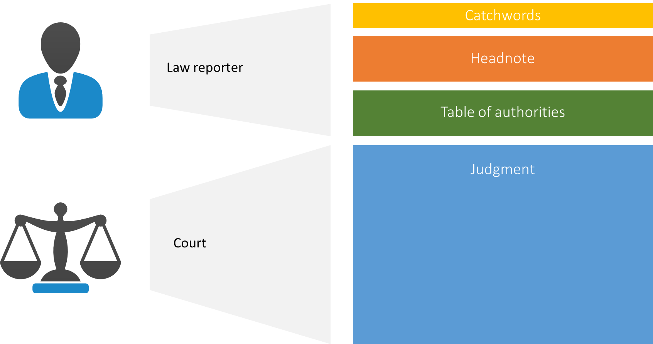
Anatomy of a law report
Notes:
I think it is important to understanding the constituent parts of a law report.
The judgment as delivered by the court, and it is this part that actually contains the rule of law.
The extra information added by the Editor or law reported are: catchwords, a headnote, and a list of authorities that have been cited in the case.
These additions - while often incredibly useful, do not form part of the decision or the precedent.
Common law and the system of precedent originated in the courts of English kings in the centuries following the Norman Conquest – that is to say, it’s not that far off one thousand years old
The point I want to make here is that this stuff goes back a really really long way, and I think it’s fair to say that the kings, judges and noblemen who first devised this wonderful system of legal consistency, could never have envisaged the world we live in today, and the sheer volume of cases and data that we have to deal with.

Slide 14
Anatomy of a law report
This remains the rule of law
Notes:
I think it is important to understanding the constituent parts of a law report.
The judgment as delivered by the court, and it is this part that actually contains the rule of law.
The extra information added by the Editor or law reported are: catchwords, a headnote, and a list of authorities that have been cited in the case.
These additions - while often incredibly useful, do not form part of the decision or the precedent.
Common law and the system of precedent originated in the courts of English kings in the centuries following the Norman Conquest – that is to say, it’s not that far off one thousand years old
The point I want to make here is that this stuff goes back a really really long way, and I think it’s fair to say that the kings, judges and noblemen who first devised this wonderful system of legal consistency, could never have envisaged the world we live in today, and the sheer volume of cases and data that we have to deal with.

Slide 15
Let’s talk numbers
Notes:
There are more than 10,000 cases heard each year in the United Kingdom superior courts (the High Court, the Court of Appeal, and the Supreme Court).
There are many lesser courts and tribunals which I haven’t included in the stats. So there must exist a high quality threshold for the cases to be selected for reporting.
Not all cases introduce a new principle or new rule, but this begs a question – how do you decide?

Slide 16
Let’s talk numbers
> 10,000 cases heard each year in the UK superior courts
Notes:
There are more than 10,000 cases heard each year in the United Kingdom superior courts (the High Court, the Court of Appeal, and the Supreme Court).
There are many lesser courts and tribunals which I haven’t included in the stats. So there must exist a high quality threshold for the cases to be selected for reporting.
Not all cases introduce a new principle or new rule, but this begs a question – how do you decide?

Slide 17
Let’s talk numbers
> 10,000 cases heard each year in the UK superior courts
< 15% of these cases are reported in any report series
Notes:
There are more than 10,000 cases heard each year in the United Kingdom superior courts (the High Court, the Court of Appeal, and the Supreme Court).
There are many lesser courts and tribunals which I haven’t included in the stats. So there must exist a high quality threshold for the cases to be selected for reporting.
Not all cases introduce a new principle or new rule, but this begs a question – how do you decide?

Slide 18
Let’s talk numbers
> 10,000 cases heard each year in the UK superior courts
< 15% of these cases are reported in any report series
There is an assumption that this is “all you need to know”
Notes:
There are more than 10,000 cases heard each year in the United Kingdom superior courts (the High Court, the Court of Appeal, and the Supreme Court).
There are many lesser courts and tribunals which I haven’t included in the stats. So there must exist a high quality threshold for the cases to be selected for reporting.
Not all cases introduce a new principle or new rule, but this begs a question – how do you decide?

Slide 19
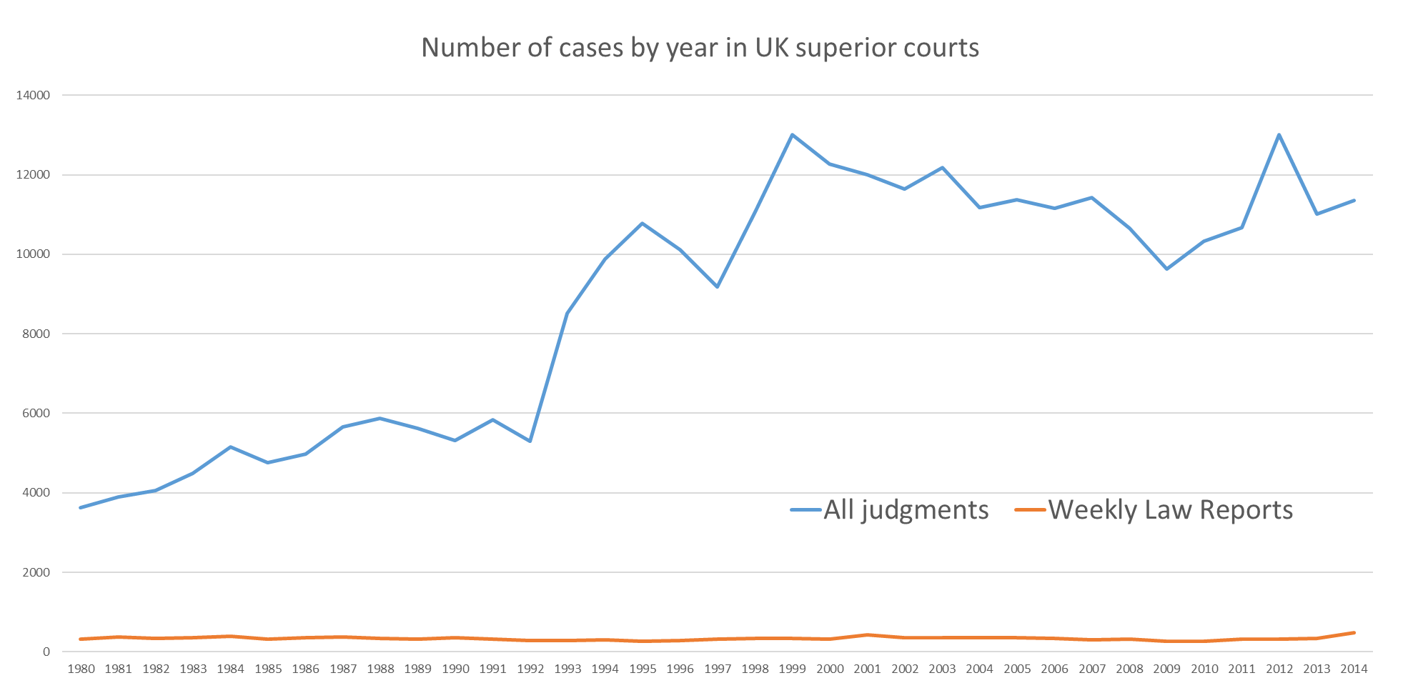
40 years of UK law
Notes:
So how much case law are we talking about? What size is this data set?
Let’s take an example from the UK. The Weekly Law Reports is a highly regarded series produced by the Incorporated Council of Law Reporting. The Council was established in 1865 as a charity to improve the reporting of cases in the UK and today they are the most authoritative and respected publisher of high quality law reports.
The Weekly Law Reports contains about 400 to 500 cases. It started in 1953 and contains about 30,000 cases.
That sounds like quite a lot of information already, however. The Weekly Law Reports is a subset of cases decided – it contains the cases that have been chosen to be reported by the Incorporated Council.
They are not a comprehensive account of the entirety of the law as delivered.

Slide 20
A few observations
Notes:
There are more than 10,000 cases heard each year in the United Kingdom superior courts (the High Court, the Court of Appeal, and the Supreme Court).
There are many lesser courts and tribunals which I haven’t included in the stats. So there must exist a high quality threshold for the cases to be selected for reporting.
Not all cases introduce a new principle or new rule, but this begs a question – how do you decide?

Slide 21
A few observations
Twice as many cases heard in the UK superior courts in recent years than 40 years ago, but reported cases remain flat
Notes:
There are more than 10,000 cases heard each year in the United Kingdom superior courts (the High Court, the Court of Appeal, and the Supreme Court).
There are many lesser courts and tribunals which I haven’t included in the stats. So there must exist a high quality threshold for the cases to be selected for reporting.
Not all cases introduce a new principle or new rule, but this begs a question – how do you decide?

Slide 22
A few observations
Twice as many cases heard in the UK superior courts in recent years than 40 years ago, but reported cases remain flat
These stats don’t include lower courts and tribunals – some have key decisions
Notes:
There are more than 10,000 cases heard each year in the United Kingdom superior courts (the High Court, the Court of Appeal, and the Supreme Court).
There are many lesser courts and tribunals which I haven’t included in the stats. So there must exist a high quality threshold for the cases to be selected for reporting.
Not all cases introduce a new principle or new rule, but this begs a question – how do you decide?

Slide 23
A few observations
Twice as many cases heard in the UK superior courts in recent years than 40 years ago, but reported cases remain flat
These stats don’t include lower courts and tribunals – some have key decisions
What happens to the other 85% of cases – so much of the law isn’t used
Notes:
There are more than 10,000 cases heard each year in the United Kingdom superior courts (the High Court, the Court of Appeal, and the Supreme Court).
There are many lesser courts and tribunals which I haven’t included in the stats. So there must exist a high quality threshold for the cases to be selected for reporting.
Not all cases introduce a new principle or new rule, but this begs a question – how do you decide?

Slide 24
A few observations
Twice as many cases heard in the UK superior courts in recent years than 40 years ago, but reported cases remain flat
These stats don’t include lower courts and tribunals – some have key decisions
What happens to the other 85% of cases – so much of the law isn’t used
Justis has around one million cases in its collections which have never been reported
Notes:
There are more than 10,000 cases heard each year in the United Kingdom superior courts (the High Court, the Court of Appeal, and the Supreme Court).
There are many lesser courts and tribunals which I haven’t included in the stats. So there must exist a high quality threshold for the cases to be selected for reporting.
Not all cases introduce a new principle or new rule, but this begs a question – how do you decide?

Slide 25
Law Reporting – a human enterprise
Notes:
The limitations of law reporting ultimately stem from the fact that it’s a human enterprise.
Human enterprises have some inescapable problems.
Number one is that humans are expensive. Law reports are produced by skilled lawyers, and skilled lawyers are even more expensive than ordinary humans.
Humans are also flawed creatures who come with inherent biases. When you can only report a subset of cases, there is inevitably some sort of selection process to decide which ones to write about. I wouldn’t dare to suggest that official law reporters are anything other than consummate professionals who do their best work in all circumstances, but I can also say that neither I nor anyone else has any real insight into what the selection criteria for reported cases actually are.
All humans come with biases – we all have different areas of interest, different areas of expertise, different knowledge and different opinions or affiliations. As generations pass we live in different times with different social and political climates. It would be naïve to think that these factors have absolutely no impact on the selection of reported cases, but perhaps more fundamentally is that we simply don’t know whether or when they do or they don’t.
All things considered, law reporting is not scalable. As a human enterprise it can never be scalable, and it can never be consistent or predicable.

Slide 26
Law Reporting – a human enterprise
Expensive
Notes:
The limitations of law reporting ultimately stem from the fact that it’s a human enterprise.
Human enterprises have some inescapable problems.
Number one is that humans are expensive. Law reports are produced by skilled lawyers, and skilled lawyers are even more expensive than ordinary humans.
Humans are also flawed creatures who come with inherent biases. When you can only report a subset of cases, there is inevitably some sort of selection process to decide which ones to write about. I wouldn’t dare to suggest that official law reporters are anything other than consummate professionals who do their best work in all circumstances, but I can also say that neither I nor anyone else has any real insight into what the selection criteria for reported cases actually are.
All humans come with biases – we all have different areas of interest, different areas of expertise, different knowledge and different opinions or affiliations. As generations pass we live in different times with different social and political climates. It would be naïve to think that these factors have absolutely no impact on the selection of reported cases, but perhaps more fundamentally is that we simply don’t know whether or when they do or they don’t.
All things considered, law reporting is not scalable. As a human enterprise it can never be scalable, and it can never be consistent or predicable.

Slide 27
Law Reporting – a human enterprise
Expensive – and guess who has to pay?
Notes:
The limitations of law reporting ultimately stem from the fact that it’s a human enterprise.
Human enterprises have some inescapable problems.
Number one is that humans are expensive. Law reports are produced by skilled lawyers, and skilled lawyers are even more expensive than ordinary humans.
Humans are also flawed creatures who come with inherent biases. When you can only report a subset of cases, there is inevitably some sort of selection process to decide which ones to write about. I wouldn’t dare to suggest that official law reporters are anything other than consummate professionals who do their best work in all circumstances, but I can also say that neither I nor anyone else has any real insight into what the selection criteria for reported cases actually are.
All humans come with biases – we all have different areas of interest, different areas of expertise, different knowledge and different opinions or affiliations. As generations pass we live in different times with different social and political climates. It would be naïve to think that these factors have absolutely no impact on the selection of reported cases, but perhaps more fundamentally is that we simply don’t know whether or when they do or they don’t.
All things considered, law reporting is not scalable. As a human enterprise it can never be scalable, and it can never be consistent or predicable.

Slide 28
Law Reporting – a human enterprise
Expensive – and guess who has to pay?
Selections are made by people - Inherent bias
Notes:
The limitations of law reporting ultimately stem from the fact that it’s a human enterprise.
Human enterprises have some inescapable problems.
Number one is that humans are expensive. Law reports are produced by skilled lawyers, and skilled lawyers are even more expensive than ordinary humans.
Humans are also flawed creatures who come with inherent biases. When you can only report a subset of cases, there is inevitably some sort of selection process to decide which ones to write about. I wouldn’t dare to suggest that official law reporters are anything other than consummate professionals who do their best work in all circumstances, but I can also say that neither I nor anyone else has any real insight into what the selection criteria for reported cases actually are.
All humans come with biases – we all have different areas of interest, different areas of expertise, different knowledge and different opinions or affiliations. As generations pass we live in different times with different social and political climates. It would be naïve to think that these factors have absolutely no impact on the selection of reported cases, but perhaps more fundamentally is that we simply don’t know whether or when they do or they don’t.
All things considered, law reporting is not scalable. As a human enterprise it can never be scalable, and it can never be consistent or predicable.

Slide 29
Law Reporting – a human enterprise
Expensive – and guess who has to pay?
Selections are made by people - Inherent bias
Other influences
Notes:
The limitations of law reporting ultimately stem from the fact that it’s a human enterprise.
Human enterprises have some inescapable problems.
Number one is that humans are expensive. Law reports are produced by skilled lawyers, and skilled lawyers are even more expensive than ordinary humans.
Humans are also flawed creatures who come with inherent biases. When you can only report a subset of cases, there is inevitably some sort of selection process to decide which ones to write about. I wouldn’t dare to suggest that official law reporters are anything other than consummate professionals who do their best work in all circumstances, but I can also say that neither I nor anyone else has any real insight into what the selection criteria for reported cases actually are.
All humans come with biases – we all have different areas of interest, different areas of expertise, different knowledge and different opinions or affiliations. As generations pass we live in different times with different social and political climates. It would be naïve to think that these factors have absolutely no impact on the selection of reported cases, but perhaps more fundamentally is that we simply don’t know whether or when they do or they don’t.
All things considered, law reporting is not scalable. As a human enterprise it can never be scalable, and it can never be consistent or predicable.

Slide 30
Law Reporting – a human enterprise
Expensive – and guess who has to pay?
Selections are made by people - Inherent bias
Other influences
Not scalable
Notes:
The limitations of law reporting ultimately stem from the fact that it’s a human enterprise.
Human enterprises have some inescapable problems.
Number one is that humans are expensive. Law reports are produced by skilled lawyers, and skilled lawyers are even more expensive than ordinary humans.
Humans are also flawed creatures who come with inherent biases. When you can only report a subset of cases, there is inevitably some sort of selection process to decide which ones to write about. I wouldn’t dare to suggest that official law reporters are anything other than consummate professionals who do their best work in all circumstances, but I can also say that neither I nor anyone else has any real insight into what the selection criteria for reported cases actually are.
All humans come with biases – we all have different areas of interest, different areas of expertise, different knowledge and different opinions or affiliations. As generations pass we live in different times with different social and political climates. It would be naïve to think that these factors have absolutely no impact on the selection of reported cases, but perhaps more fundamentally is that we simply don’t know whether or when they do or they don’t.
All things considered, law reporting is not scalable. As a human enterprise it can never be scalable, and it can never be consistent or predicable.

Slide 31
How do we make sense of all this law?
Notes:
So there’s a basic problem – we just have too much law. Unfortunately, that’s never going to change, so we need to find a different, or rather, a complementary solution to make sense of it all.
We need to come up with a solution because the volume problem is not going away, and nor are common law legal systems.
There’s a well known maxim that ignorantia juris non excusat – ignorance of the law is not an excuse. Someone who is unaware of a law can’t escape liability by being unaware of it.
So as a matter of very basic principle, we have to find a way.
Fortunately, technology can help.

Slide 32
How do we make sense of all this law?
Judgments are raw and unstructured
Notes:
So there’s a basic problem – we just have too much law. Unfortunately, that’s never going to change, so we need to find a different, or rather, a complementary solution to make sense of it all.
We need to come up with a solution because the volume problem is not going away, and nor are common law legal systems.
There’s a well known maxim that ignorantia juris non excusat – ignorance of the law is not an excuse. Someone who is unaware of a law can’t escape liability by being unaware of it.
So as a matter of very basic principle, we have to find a way.
Fortunately, technology can help.

Slide 33
How do we make sense of all this law?
Judgments are raw and unstructured
There are lots of them – the volume is huge
Notes:
So there’s a basic problem – we just have too much law. Unfortunately, that’s never going to change, so we need to find a different, or rather, a complementary solution to make sense of it all.
We need to come up with a solution because the volume problem is not going away, and nor are common law legal systems.
There’s a well known maxim that ignorantia juris non excusat – ignorance of the law is not an excuse. Someone who is unaware of a law can’t escape liability by being unaware of it.
So as a matter of very basic principle, we have to find a way.
Fortunately, technology can help.

Slide 34
How do we make sense of all this law?
Judgments are raw and unstructured
There are lots of them – the volume is huge
Ignorantia juris non excusat
Notes:
So there’s a basic problem – we just have too much law. Unfortunately, that’s never going to change, so we need to find a different, or rather, a complementary solution to make sense of it all.
We need to come up with a solution because the volume problem is not going away, and nor are common law legal systems.
There’s a well known maxim that ignorantia juris non excusat – ignorance of the law is not an excuse. Someone who is unaware of a law can’t escape liability by being unaware of it.
So as a matter of very basic principle, we have to find a way.
Fortunately, technology can help.

Slide 35
How do we make sense of all this law?
Judgments are raw and unstructured
There are lots of them – the volume is huge
Ignorantia juris non excusat – “ignorance of the law is not an excuse”
Notes:
So there’s a basic problem – we just have too much law. Unfortunately, that’s never going to change, so we need to find a different, or rather, a complementary solution to make sense of it all.
We need to come up with a solution because the volume problem is not going away, and nor are common law legal systems.
There’s a well known maxim that ignorantia juris non excusat – ignorance of the law is not an excuse. Someone who is unaware of a law can’t escape liability by being unaware of it.
So as a matter of very basic principle, we have to find a way.
Fortunately, technology can help.

Slide 36
How do we make sense of all this law?
Judgments are raw and unstructured
There are lots of them – the volume is huge
Ignorantia juris non excusat – “ignorance of the law is not an excuse”
So what is the answer?
Notes:
So there’s a basic problem – we just have too much law. Unfortunately, that’s never going to change, so we need to find a different, or rather, a complementary solution to make sense of it all.
We need to come up with a solution because the volume problem is not going away, and nor are common law legal systems.
There’s a well known maxim that ignorantia juris non excusat – ignorance of the law is not an excuse. Someone who is unaware of a law can’t escape liability by being unaware of it.
So as a matter of very basic principle, we have to find a way.
Fortunately, technology can help.

Slide 37
How do we make sense of all this law?
Judgments are raw and unstructured
There are lots of them – the volume is huge
Ignorantia juris non excusat – “ignorance of the law is not an excuse”
So what is the answer? Technology can help
Notes:
So there’s a basic problem – we just have too much law. Unfortunately, that’s never going to change, so we need to find a different, or rather, a complementary solution to make sense of it all.
We need to come up with a solution because the volume problem is not going away, and nor are common law legal systems.
There’s a well known maxim that ignorantia juris non excusat – ignorance of the law is not an excuse. Someone who is unaware of a law can’t escape liability by being unaware of it.
So as a matter of very basic principle, we have to find a way.
Fortunately, technology can help.

Slide 38
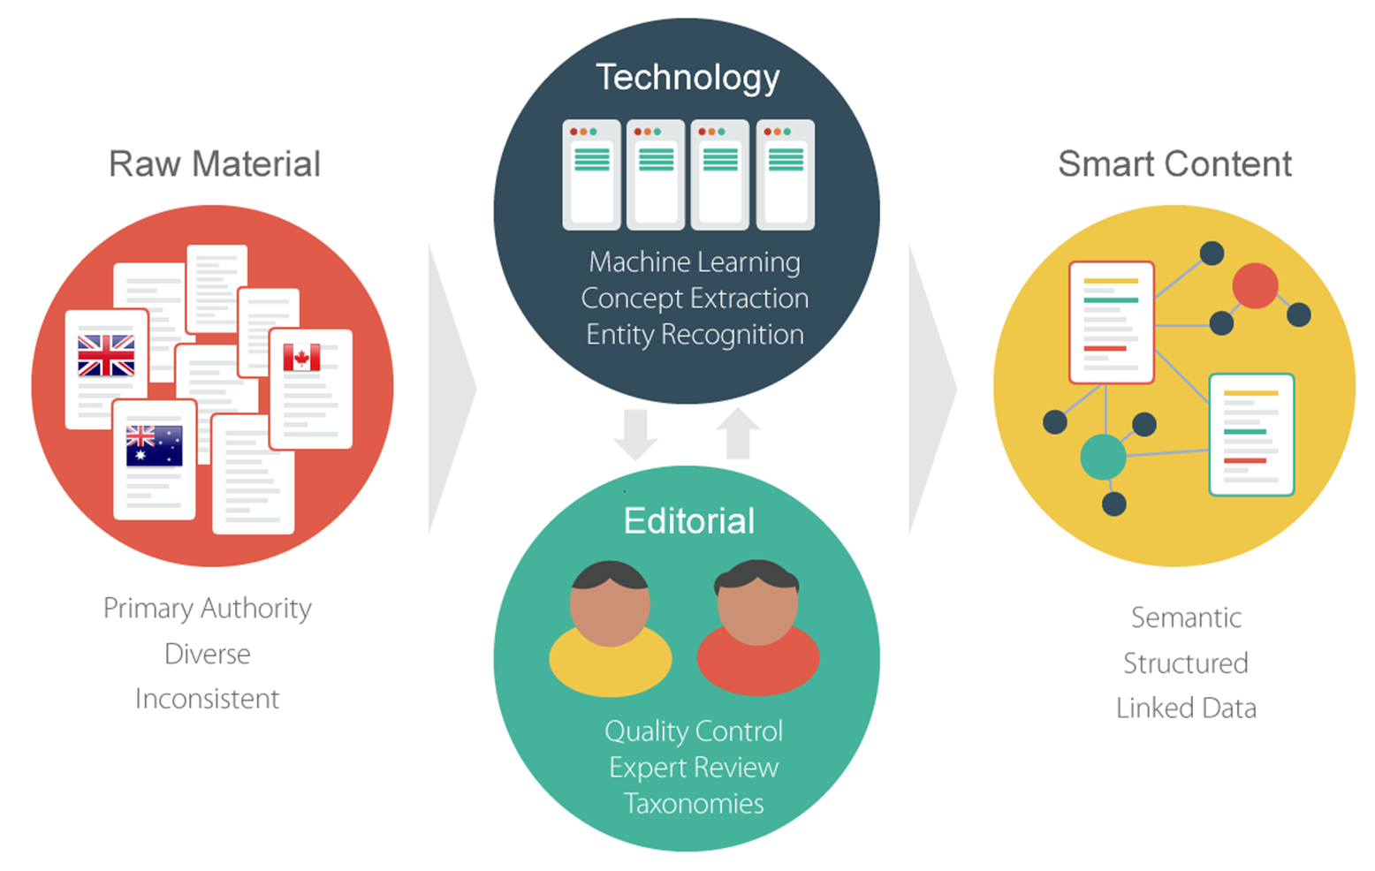
Justis/vLex Intelligence Pipeline
Notes:
Today, companies like Justis and vLex are looking at legal research in an entirely different way.
We are taking this vast corpus of data – cases in their millions – that is, the raw material of the law, if you like, and we’re applying an arsenal of data mining and artificial intelligence technologies to it to look for patterns and insights, and ultimately build what you might call an “intelligent surface” on the top of the data – a collection of tools and functionalities that allow users to easily navigate this huge information space that was quickly becoming overwhelming. The value that we and other technology providers can bring is no longer just access to content, but in the new and extraordinary ways in which we can make the content accessible.
We pipe it through various machine learning applications, such as entity recognition, concept extraction, and legal classification.
This process is largely automated but also has a considerable amount of editorial validation and quality control.
What comes out the other side is what you might then call “smart content” or “structured data”.

Slide 39
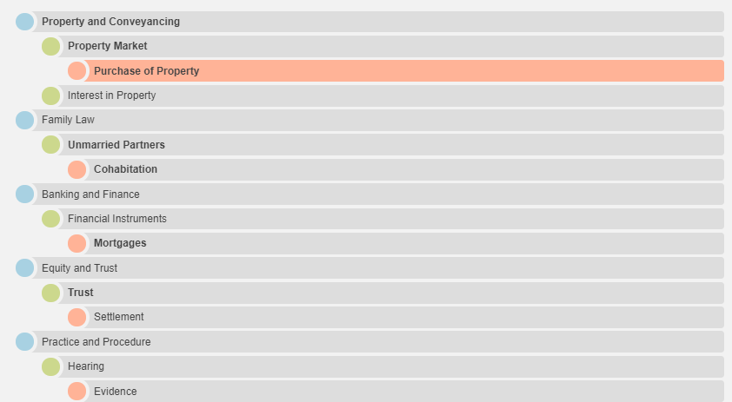
The Justis Legal Taxonomy
46 top level legal categories
9 levels deep
1.5 million concepts and phrases
A million cases consistently classified
Notes:
Let’s look at an example - the Justis Legal Taxonomy.
It’s taken us about 5 years to build this – and it’s very much a collaboration between our engineers and our legal editors. The Justis Legal Taxonomy is essentially a structured index of legal subject terms and concepts.
It starts with 46 top level categories, such as property law, equity or family law
And goes down to 9 levels deep and has almost 1.5 million concepts and phrases – it’s an enormous structure.
But most importantly, we have been able to use machine learning algorithms to consistently classify over a million cases against this taxonomy.
A huge amount of these cases has never been reported, but for the first time they can be found and accessed in the right context.
The subject terms we attach are roughly analogous to the catchwords added to judgments by law reporters. It’s not exactly the same, but
The real benefit here is the consistency.

Slide 40
Simple, effective tools
Notes:
Today, companies like Justis and vLex are looking at legal research in an entirely different way.
We are taking this vast corpus of data – cases in their millions – that is, the raw material of the law, if you like, and we’re applying an arsenal of data mining and artificial intelligence technologies to it to look for patterns and insights, and ultimately build what you might call an “intelligent surface” on the top of the data – a collection of tools and functionalities that allow users to easily navigate this huge information space that was quickly becoming overwhelming. The value that we and other technology providers can bring is no longer just access to content, but in the new and extraordinary ways in which we can make the content accessible.
We pipe it through various machine learning applications, such as entity recognition, concept extraction, and legal classification.
This process is largely automated but also has a considerable amount of editorial validation and quality control.
What comes out the other side is what you might then call “smart content” or “structured data”.

Slide 41
The Justis/vLex Legal Graph
1.3M cases
60k statutes
150k statutory instruments
1.4k courts
300k subject terms
1k report series
180M relationships
Notes:
This Taxonomy is just one part of a larger picture – the Legal Graph that Justis and vLex have produced.
It contains semantic connections between legal authorities, courts, organisations, subject terms and other agents.
The graph allows us to interrogate very large amounts of data in new ways, and mine complex information faster than we ever could before.

Slide 42
Your data
Notes:
Where this gets even more exciting when we consider your data.
Your data can go through the same data mining and structuring pipeline, with amazing results.

Slide 43
Hybrid Legal Graph
Your data
Our data
Notes:
The result is a Hybrid Legal Graph.
The really exciting opportunities arise when your data meets our data

Slide 44
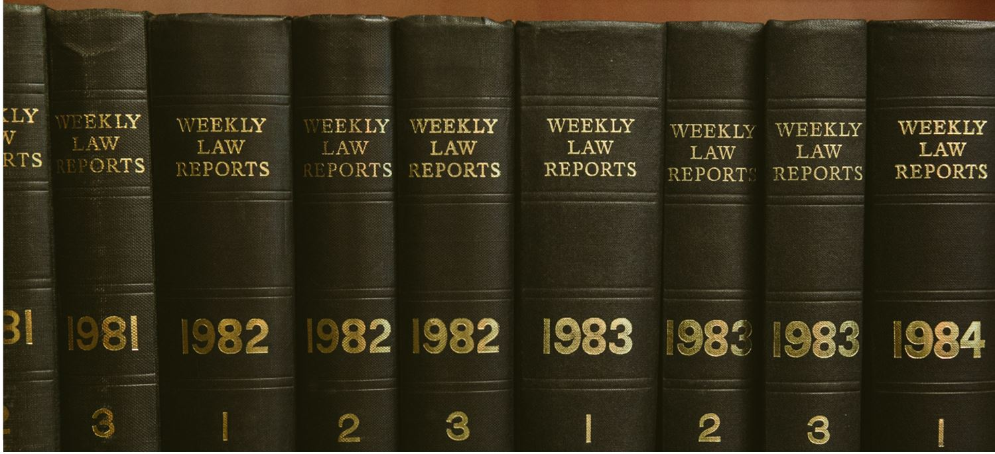
The long journey…

Slide 45
Thank you
Notes:
I hope I’ve been able to demonstrate a little of how intelligent legal research technologies and the functionalities available are actually a world away from what they used to be. They are better suited not just to facilitating legal research, but going some way towards helping us all navigate the colossal amount of law in the world.
In order to do comprehensive legal research, we can’t operate on a subset of the law. And in order to make sense of this increased volume, we need more intelligent tools to work with and understand the content.
Legal research platform providers need to go beyond document delivery, and do more with their content to provide contextually relevant insights.

